Slide 1



High-precision isotope shift measurements in highly charged ions
Lukas J. Spieß
Group of Piet O. Schmidt
QUEST Institute for Experimental Quantum Metrology
PTB Braunschweig, Germany
ECTI 2023

Slide 2
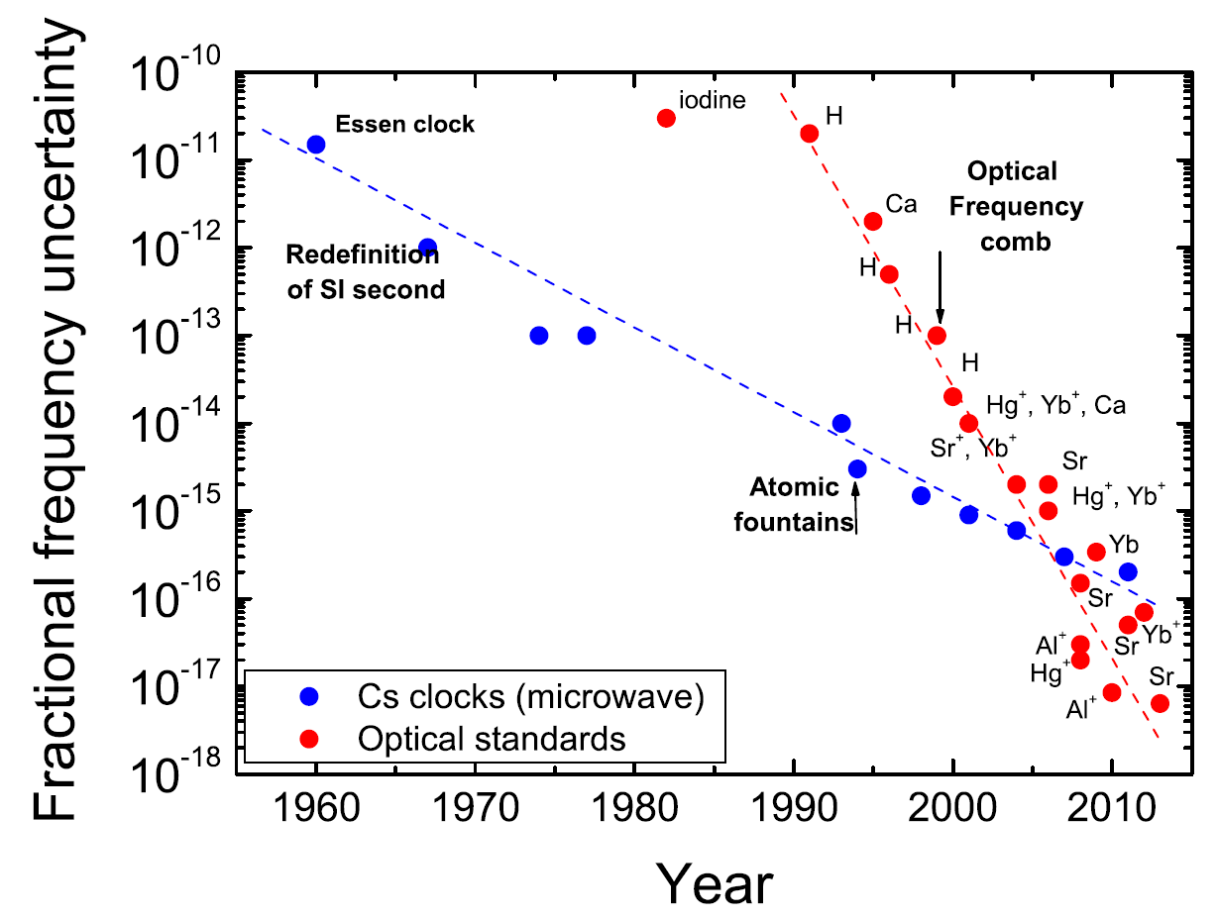
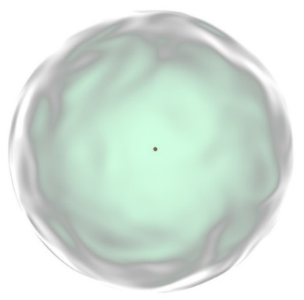
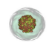
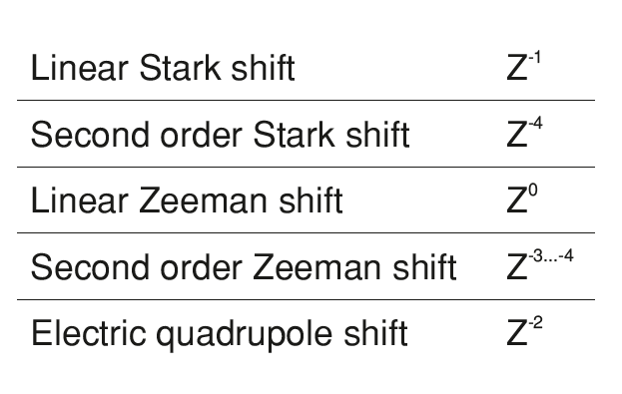
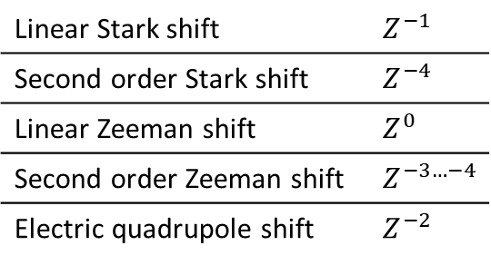
Optical clocks
Highly charged ions
Poli et al., Riv. Nuovo Cimento 36 (2013)
z
H atom
H-like
ion
Linear Stark shift | $$Z^{−1}$$
Second order Stark shift | $$Z^{−4}$$
Linear Zeeman shift | $$Z^{0}$$
Second order Zeeman shift | $$Z^{−3…−4}$$
Electric quadrupole shift | $$Z^{−2}$$
Intrinsically less sensitive to external perturbations
Al⁺ 9.4 × 10⁻¹⁹
Brewer et al., Phys. Rev. Lett. 123, 033201 (2019)
Kozlov et al., Rev. Mod. Phys 90, 045005 (2018)

Slide 3
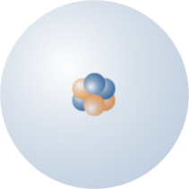


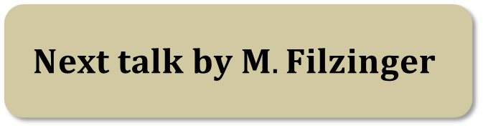
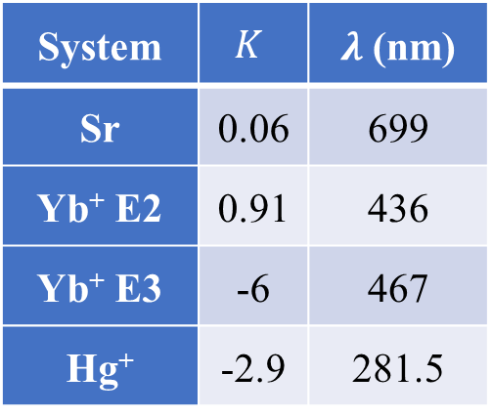
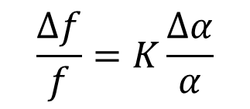
Fundamental physics with HCI
$$φ$$
System | $$K$$ | $λ$ (nm)
Sr | 0.06 | 699
Yb⁺ E2 | 0.91 | 436
Yb⁺ E3 | -6 | 467
Hg⁺ | -2.9 | 281.5
Ir¹⁷⁺ T1 | -22 | ca. 280
Ir¹⁷⁺ T2 | 145 | ca. 1980
Cf¹⁶⁺* T1 | 59 | ca. 775
Cf¹⁷⁺* | -48 | ca. 535
Atom 1
Atom 2
$$α$$
1/137
$$Next talk by M. Filzinger$$
$$\frac{Δf}{f}=K\frac{Δα}{α}$$

Slide 4
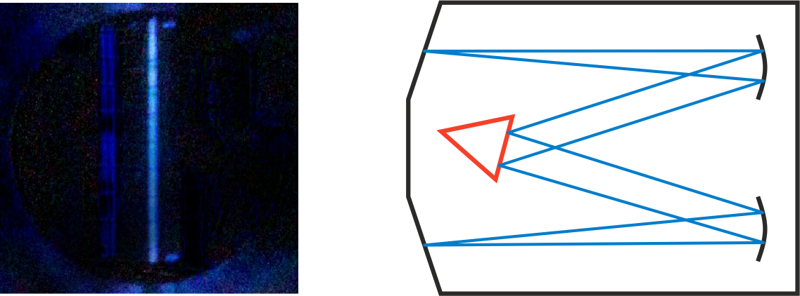
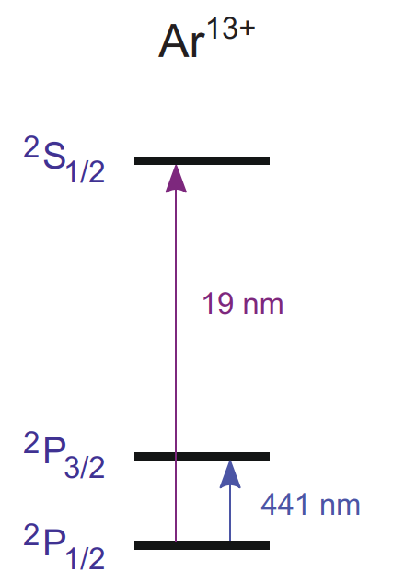
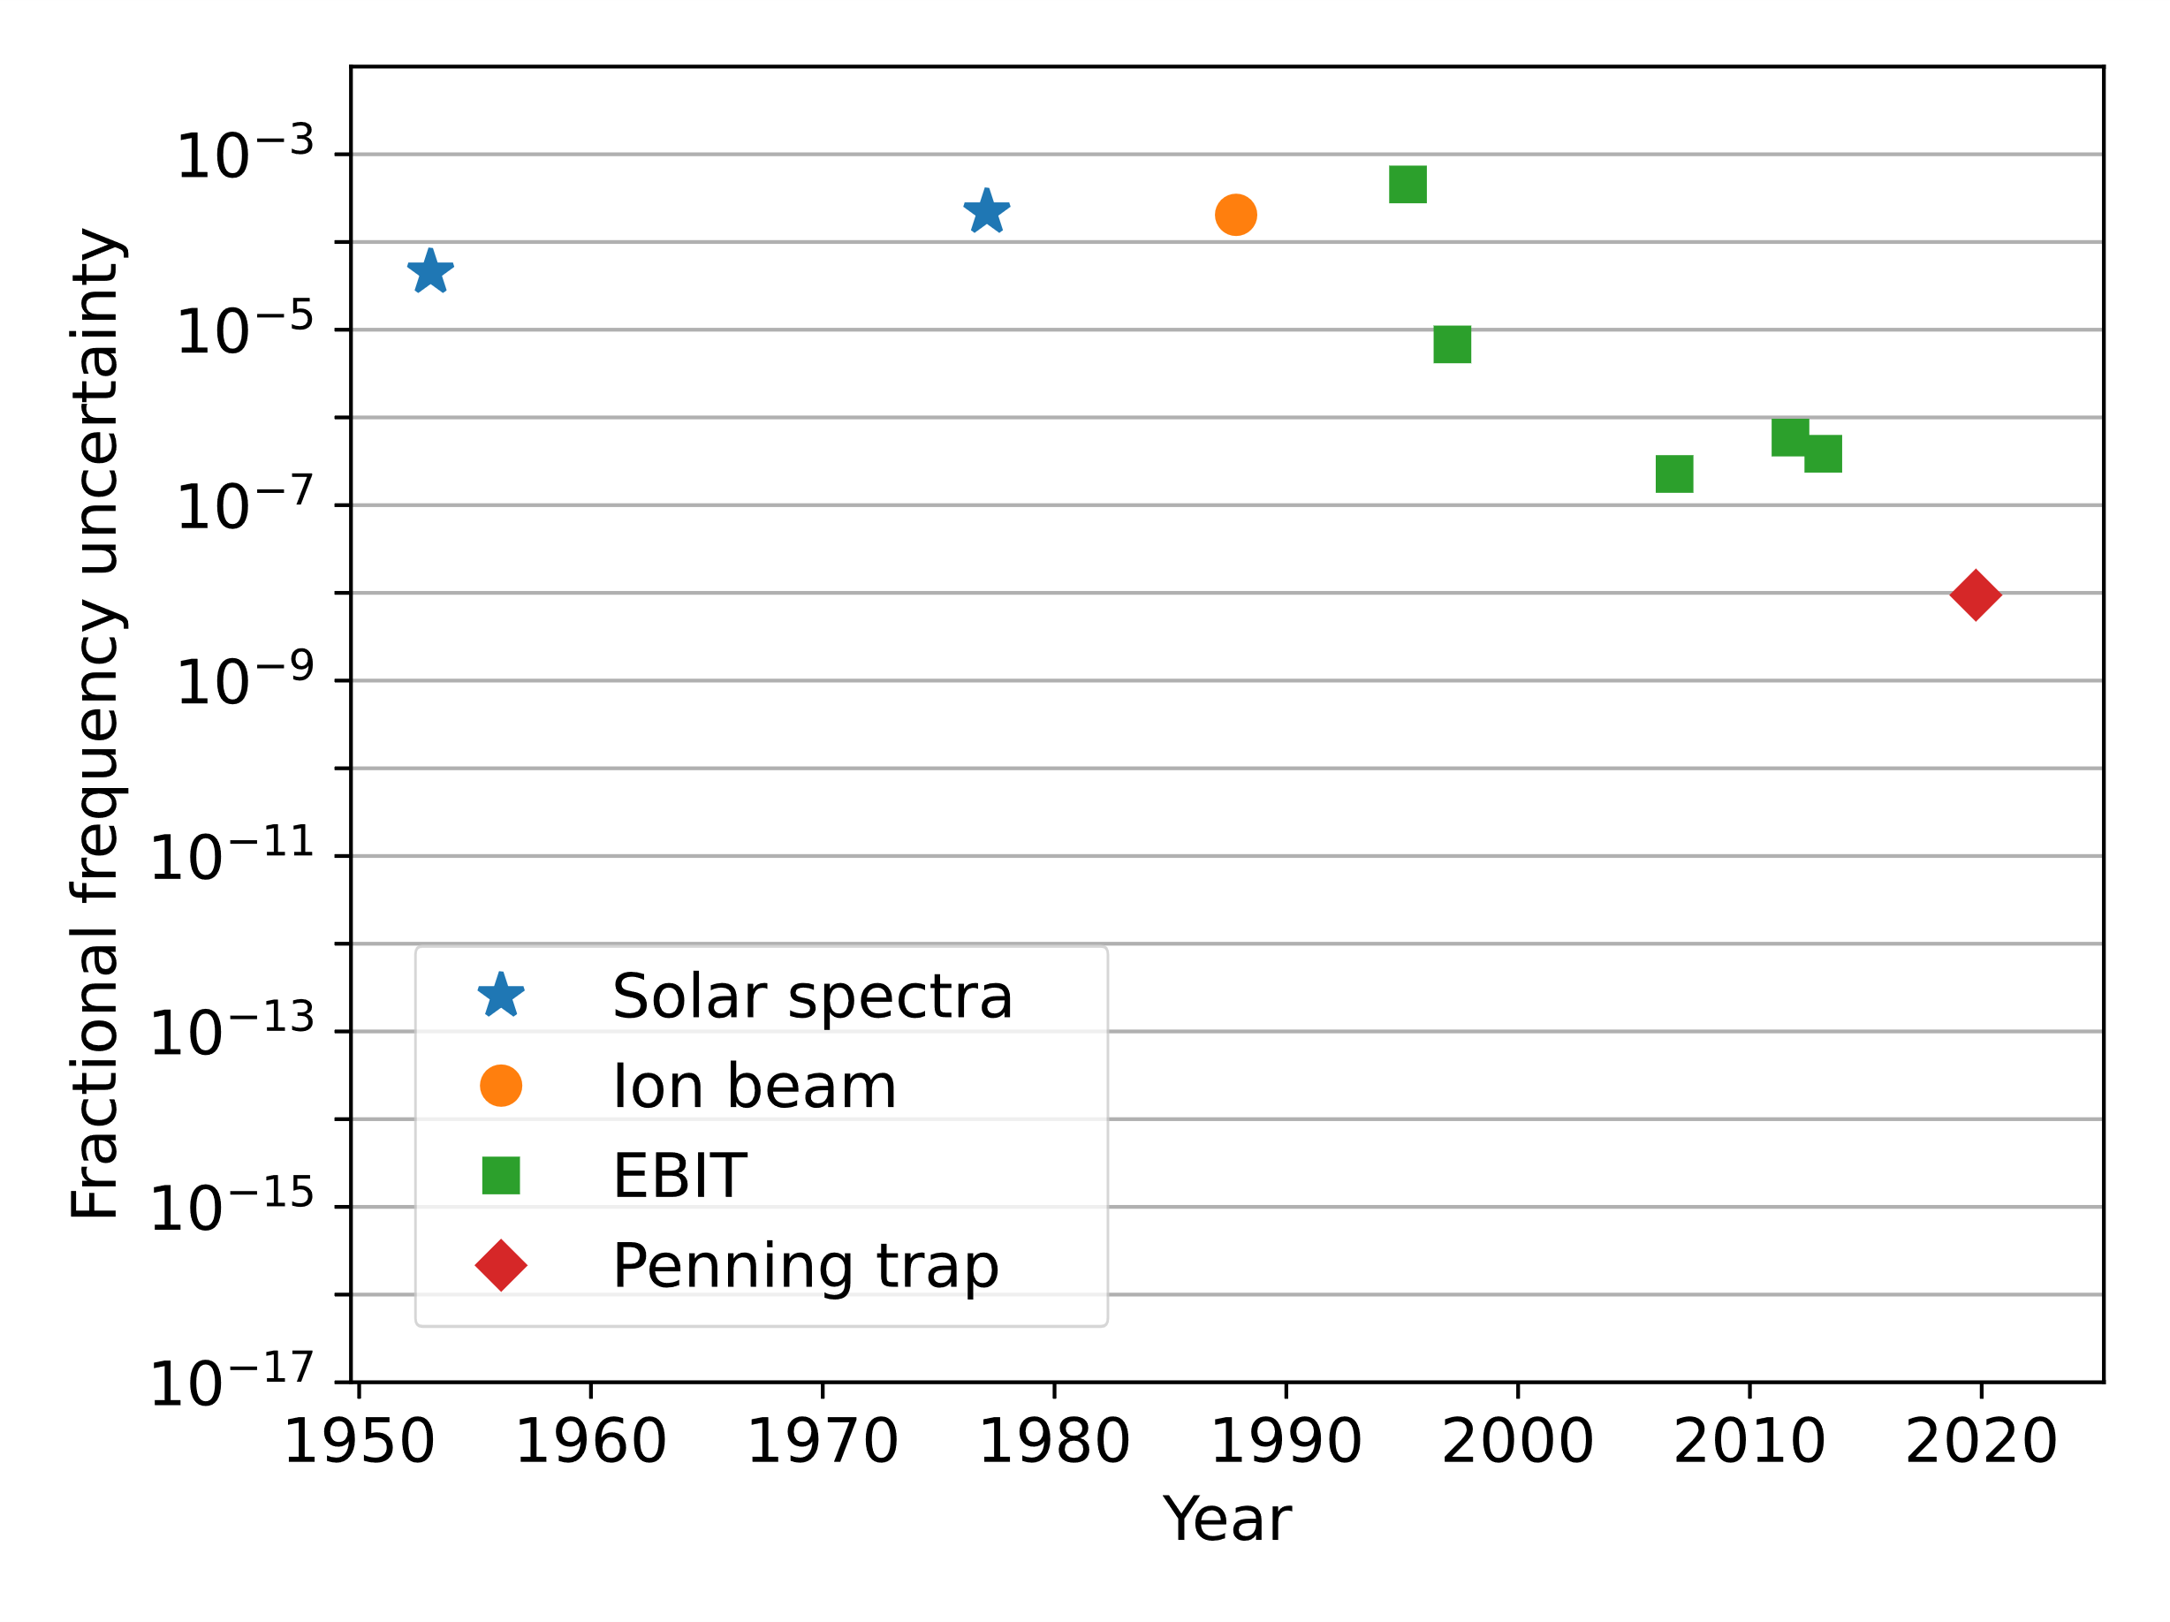
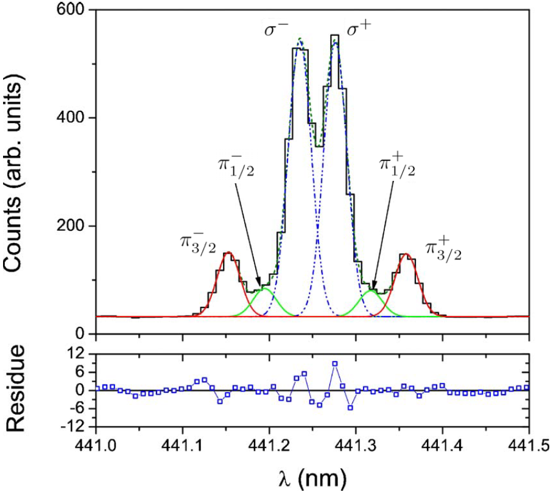

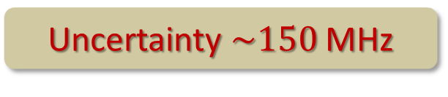
State-of-the-art HCI spectroscopy
Ar¹³⁺
Plasma
Grating spectrometer
$$\sim 45 GHz$$
Optical clocks
Soria Orts et al., PRA 76, 052501 (2007)
Uncertainty $\sim 150$MHz

Slide 5
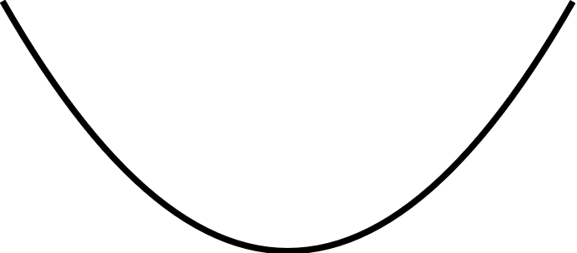

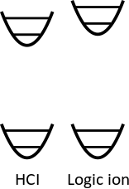
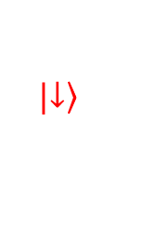
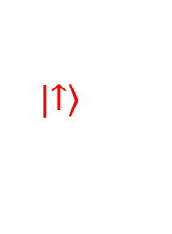
Quantum logic spectroscopy
Dipole-allowed optical transitions for
laser cooling / electron shelving
Coupled motion:
Sympathetic cooling and
quantum logic spectroscopy
Spectroscopy ion
Ar¹³⁺
Logic ion
Be⁺
²P_{3/2}
?
$$|\left.↑\right\rangle$$
441 nm
M1
Qubit
Cooling
transition
²P_{1/2}
$$|\left.↓\right\rangle$$
Schmidt et al., Science 309 (2005)

Slide 6
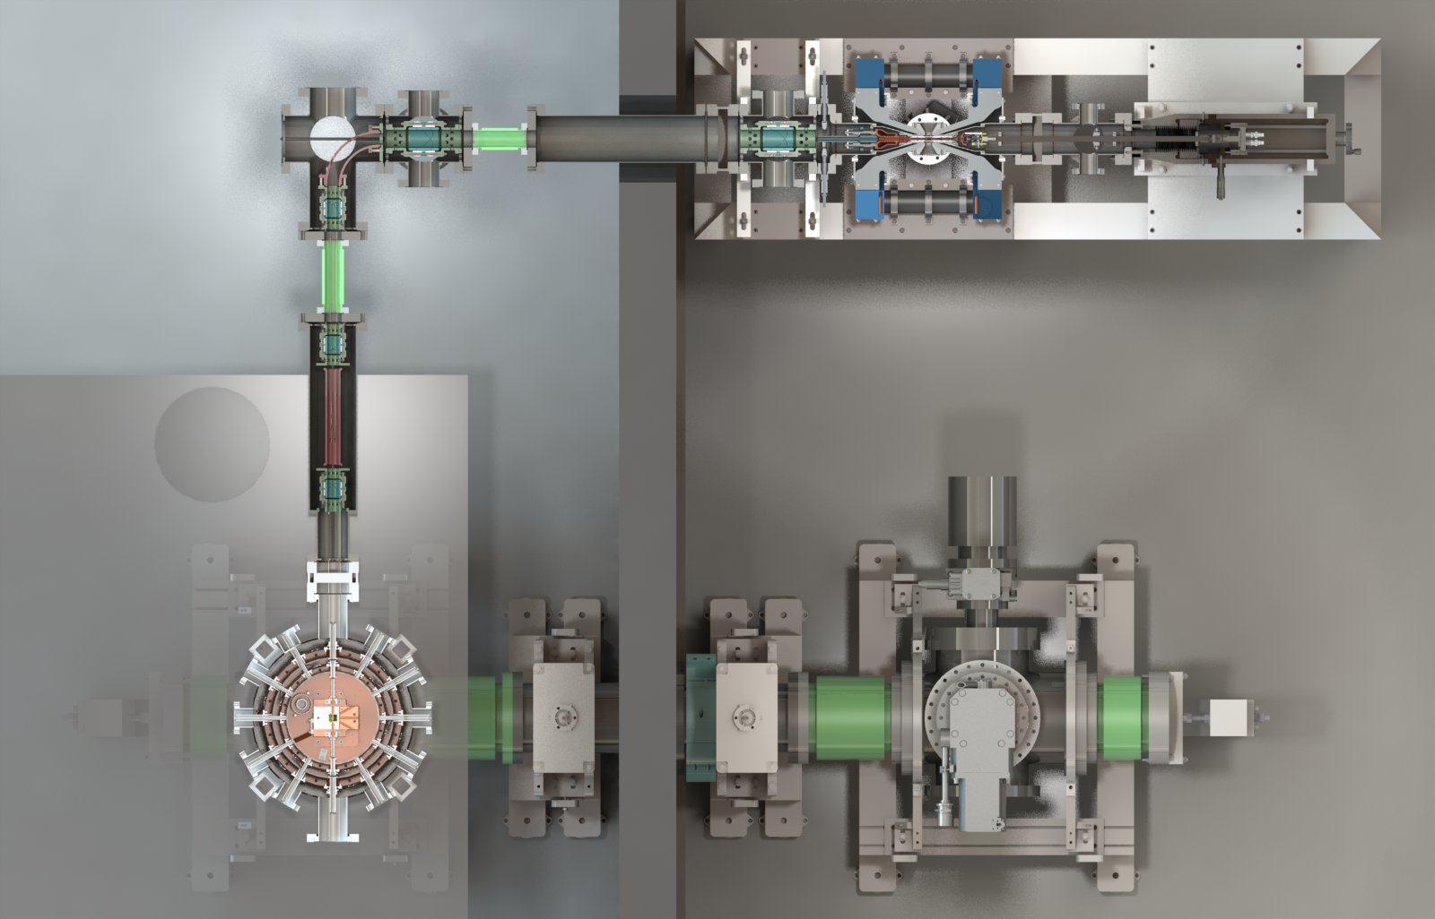
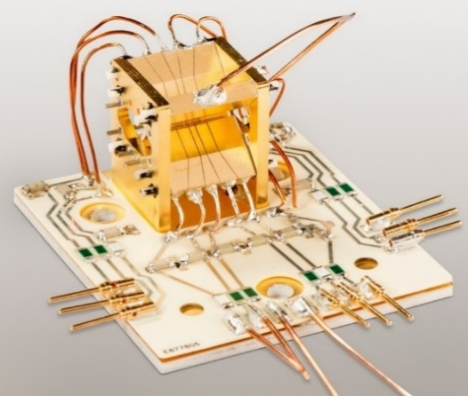
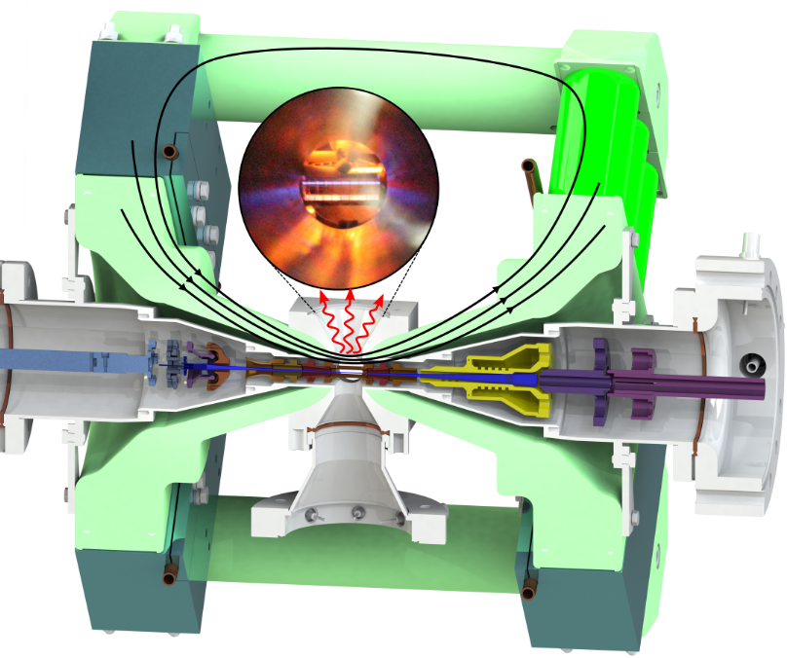
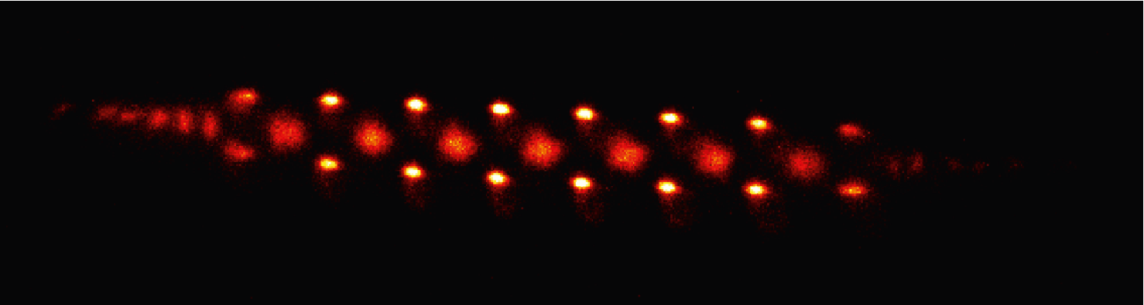
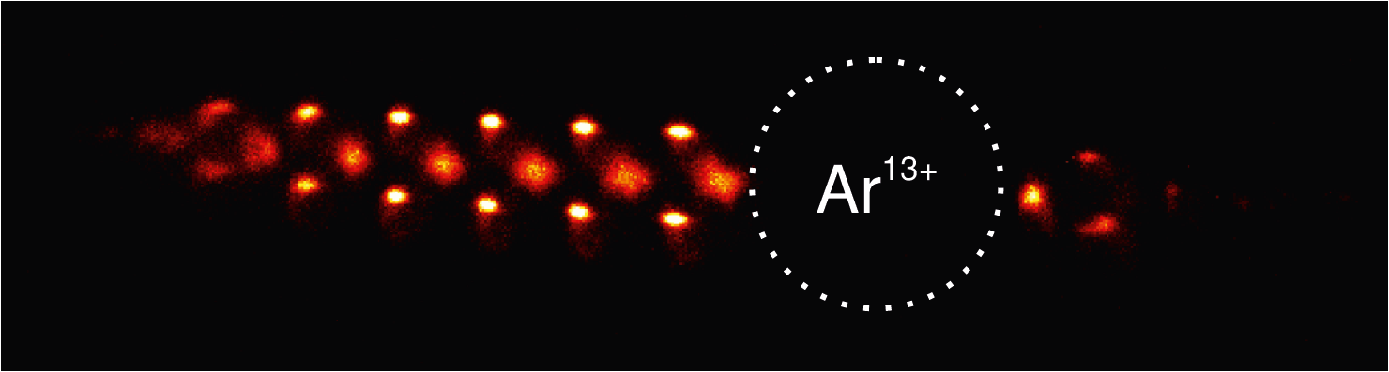
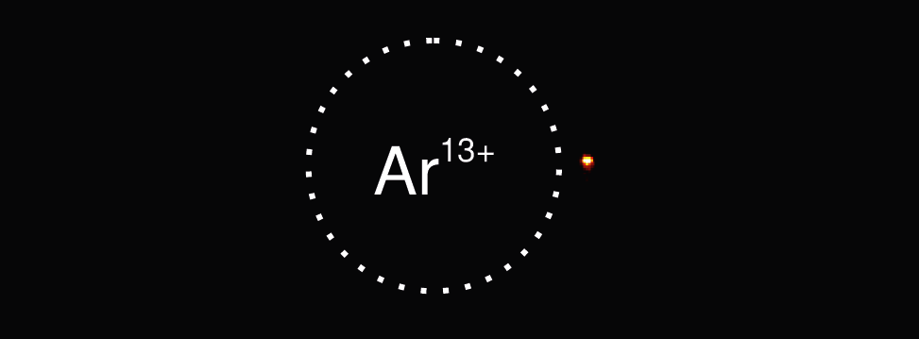
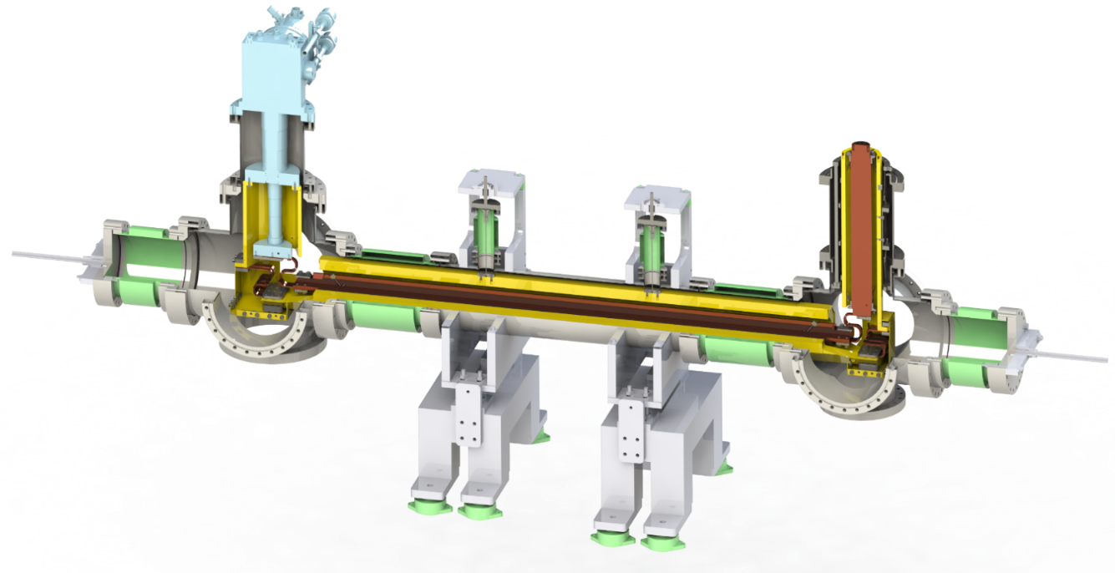
HCI lab at PTB
Machine
room
Cryogenic system
Laser lab
Linear Paul trap
Wall
Micke et al., Rev. Sci. Instrum. 89, 063109 (2018)
Micke et al., Rev. Sci. Instrum. 90 065104 (2019)
1 m
Beamline
Leopold et al., Rev. Sci Inst. 90, 073201 (2019)
Time-of-flight
separation,
deceleration
Electron beam ion trap
6

Slide 7
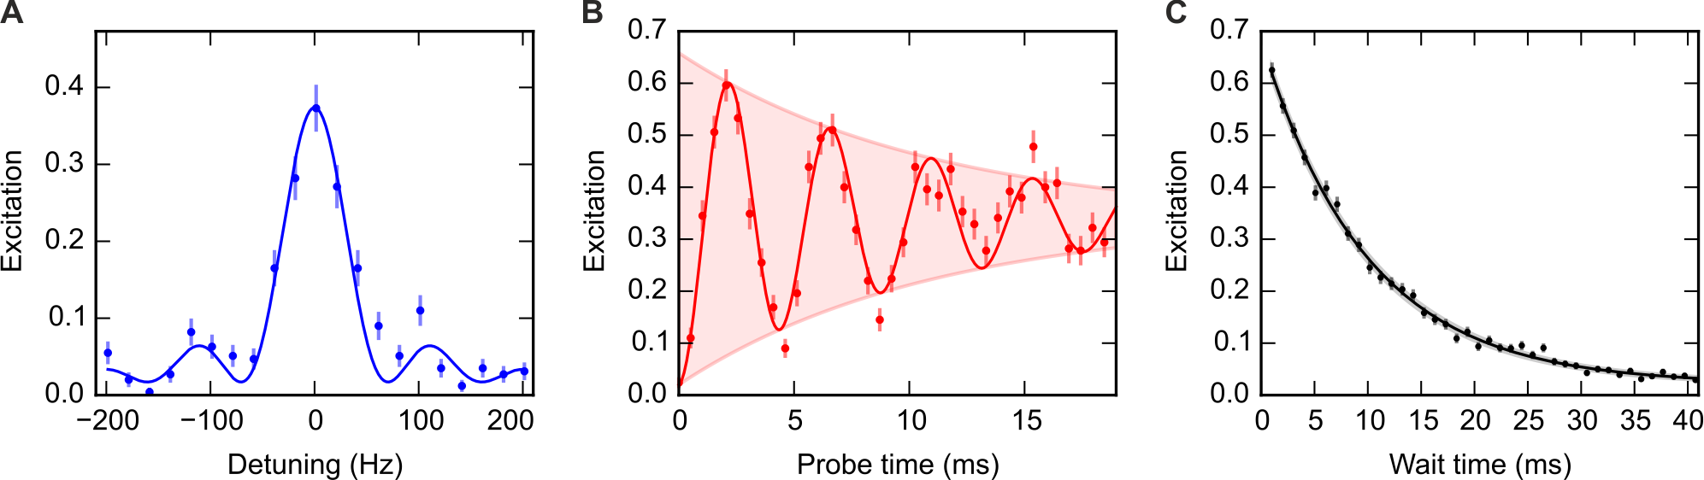
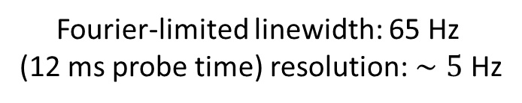
Quantum logic spectroscopy
Fourier-limited linewidth: 65 Hz
(12 ms probe time) resolution: $∼5$ Hz
decoherence dominated by
excited state lifetime of 9.97(26)ms
²P_{3/2}
441 nm
²P_{1/2}
Ar¹³⁺
Micke et al., Nature 578, 60 (2020)

Slide 8
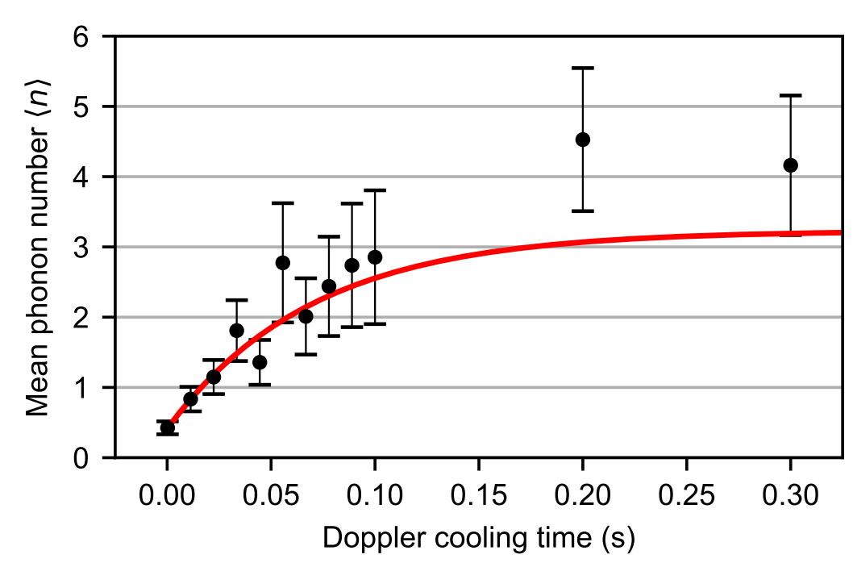
Cooling is challenging
Large q/m mismatch between ions
large difference in amplitudes
inefficient cooling of radial modes
radial mode #1:
→ strong cooling
radial mode #2:
→ weak cooling
Ar¹³⁺
Be⁺
laser
cooling
Doppler cooling time of seconds required
Ar¹³⁺
Be⁺
laser
cooling
King et al., Phys. Rev. X 11, 041049 (2021)

Slide 9
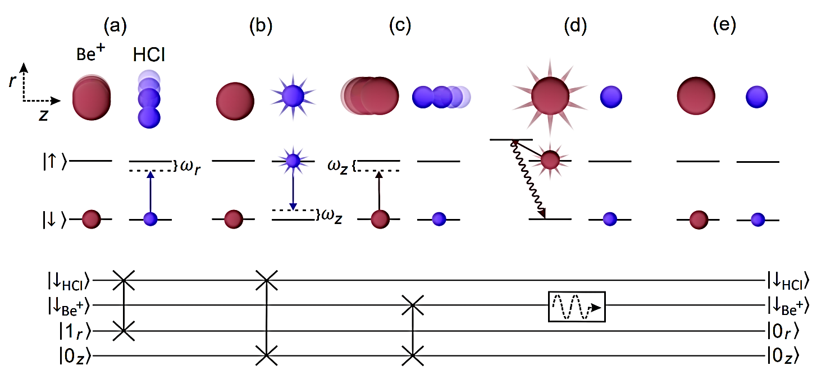


Cooling with quantum logic
Coherently transfer radial mode phonons to efficiently-cooled axial modes
Algorithmic cooling
$$ω_{z}$$
$$ω_{z}$$
radial motion→ HCI spin
HCI spin → axial motion
axial ground state cooling
Universal applicable
Does not depend on q/m
King et al., Phys. Rev. X 11, 041049 (2021)

Slide 10
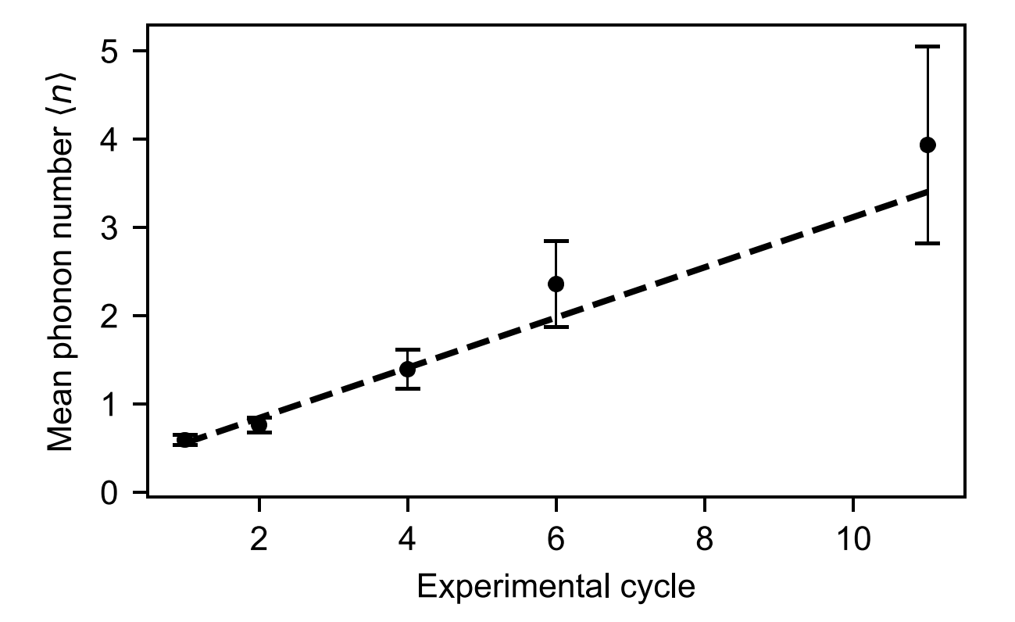
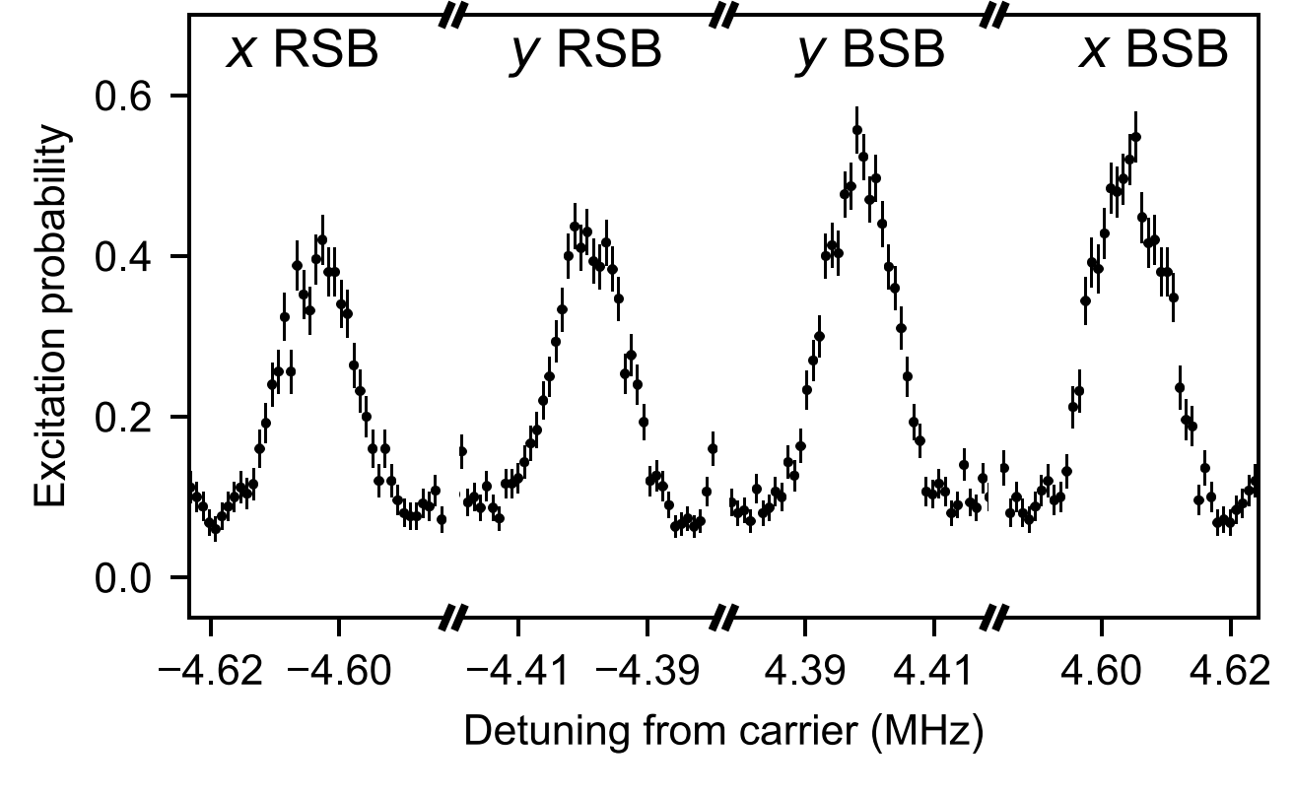
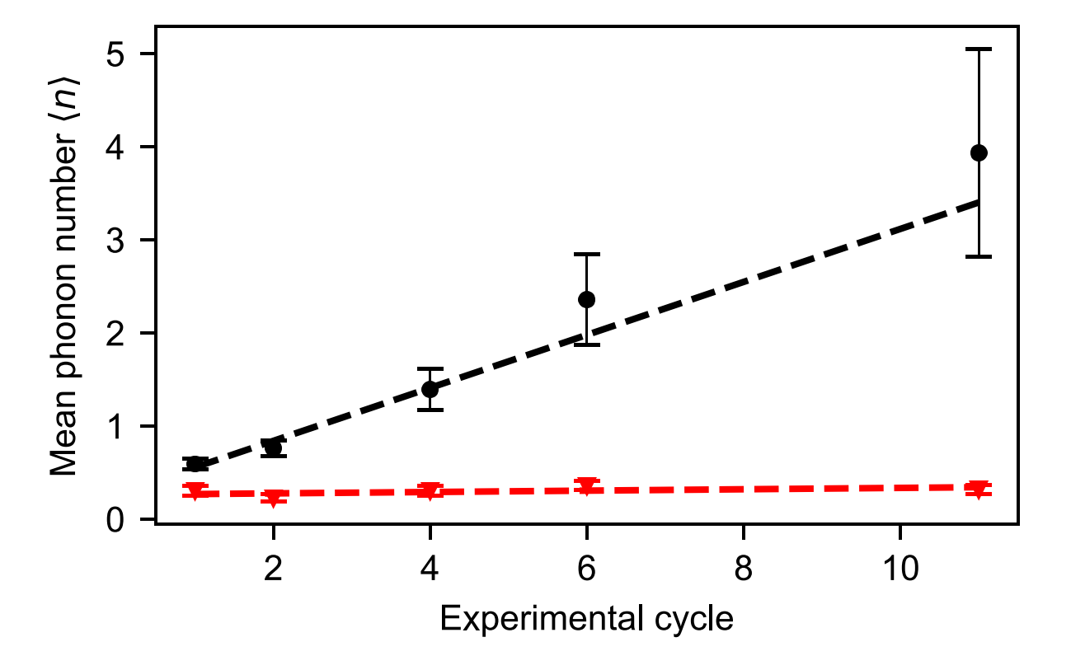
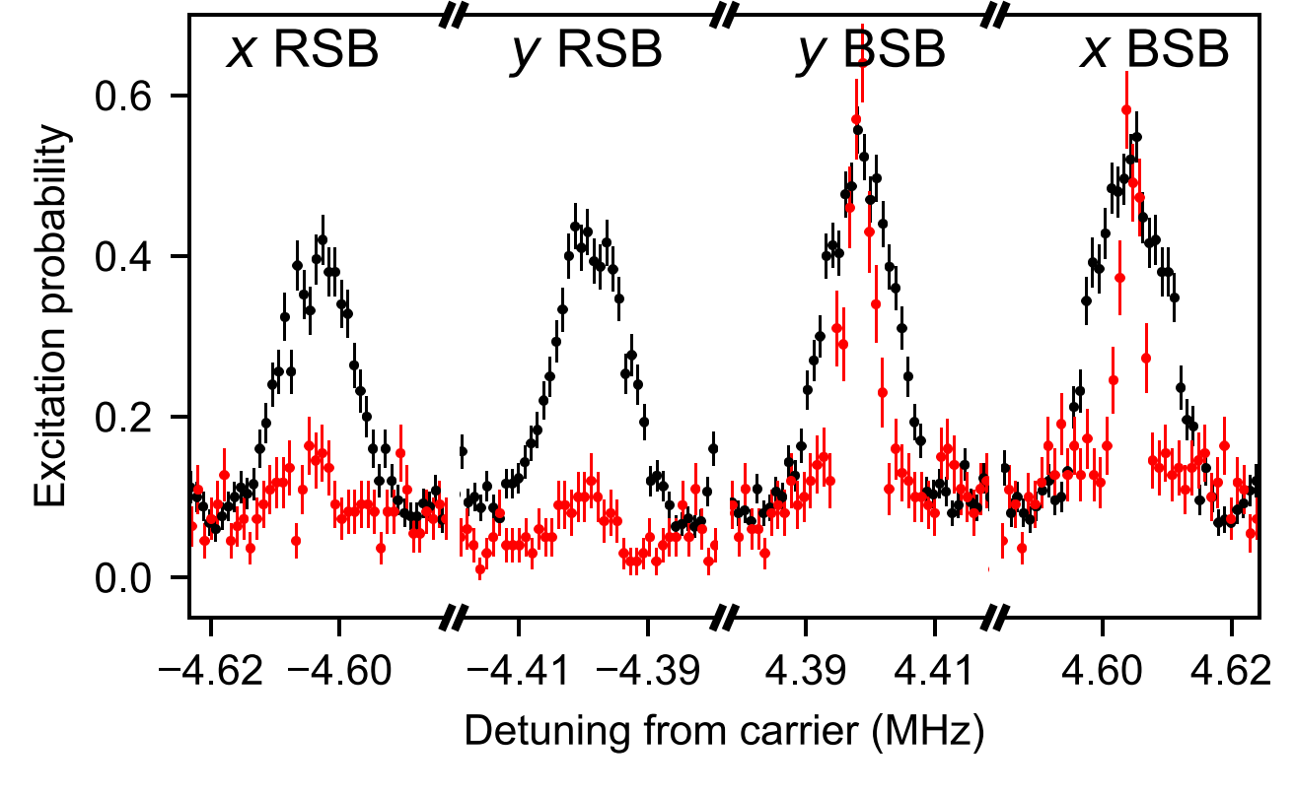


Cooling during clock operation
Heating rate: $Γ_{h}∝Z^{2}$
$Γ_{h}\sim 10$quanta/s
Suppressed by
Interleaved cooling
Coldest HCI of all time!
T < 200 µK in all modes
Enables <10⁻¹⁸ levels of inaccuracy for
HCI-based optical clocks
King et al., Phys. Rev. X 11, 041049 (2021)

Slide 11
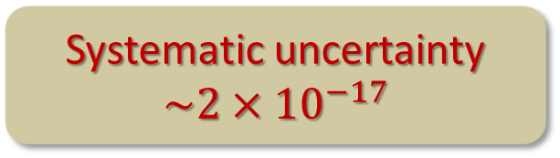
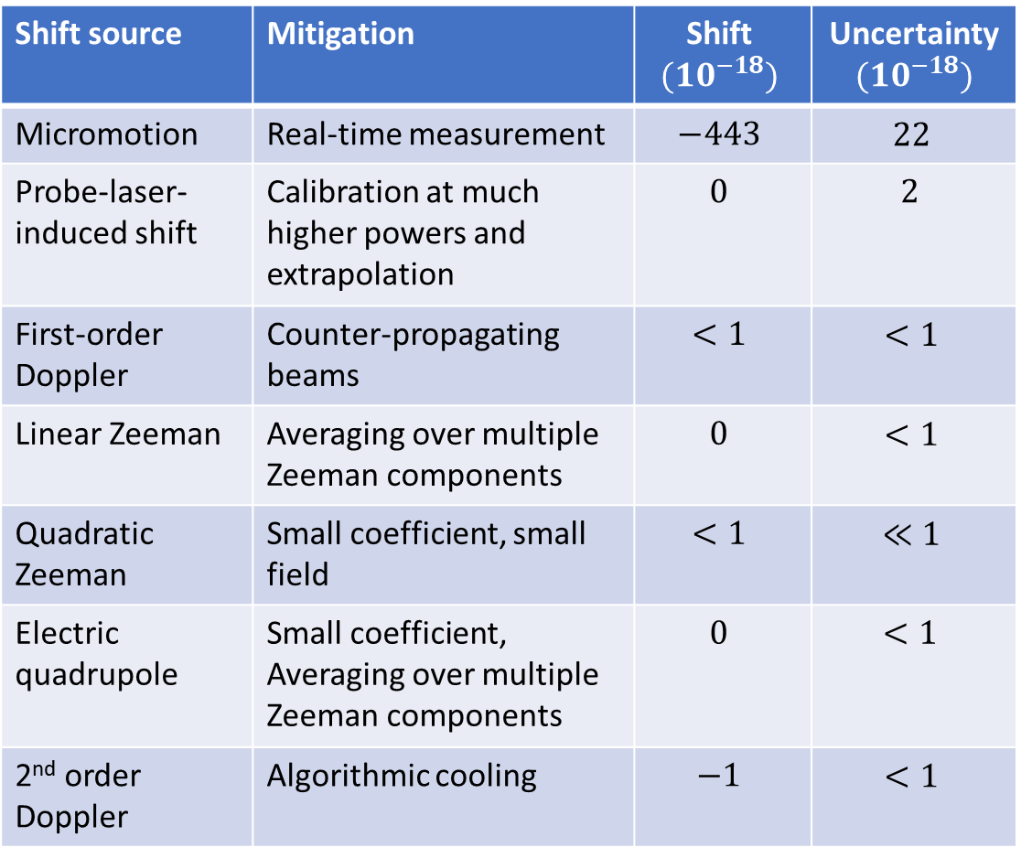
Summary of systematic shifts (⁴⁰Ar¹³⁺)
Shift source | Mitigation | Shift $$(10^{−18})$$ | Uncertainty $$(10^{−18})$$
Micromotion | Real-time measurement | $$−443$$ | $$22$$
Probe-laser-induced shift | Calibration at much higher powers and extrapolation | $$0$$ | $$2$$
First-order Doppler | Counter-propagating beams | $$<1$$ | $$<1$$
Linear Zeeman | Averaging over multiple Zeeman components | $$0$$ | $$<1$$
Quadratic Zeeman | Small coefficient, small field | $$<1$$ | $$≪1$$
Electric quadrupole | Small coefficient, Averaging over multiple Zeeman components | $$0$$ | $$<1$$
2nd order Doppler | Algorithmic cooling | $$−1$$ | $$<1$$
no fundamental
limitations
Systematic uncertainty $\sim 2×{10}^{−17}$
atomic data from Y-M. Yu and B.K. Sahoo, PRA 99, 022513 (2019)
King, Spieß et al., Nature 611, 43–47 (2022)

Slide 12
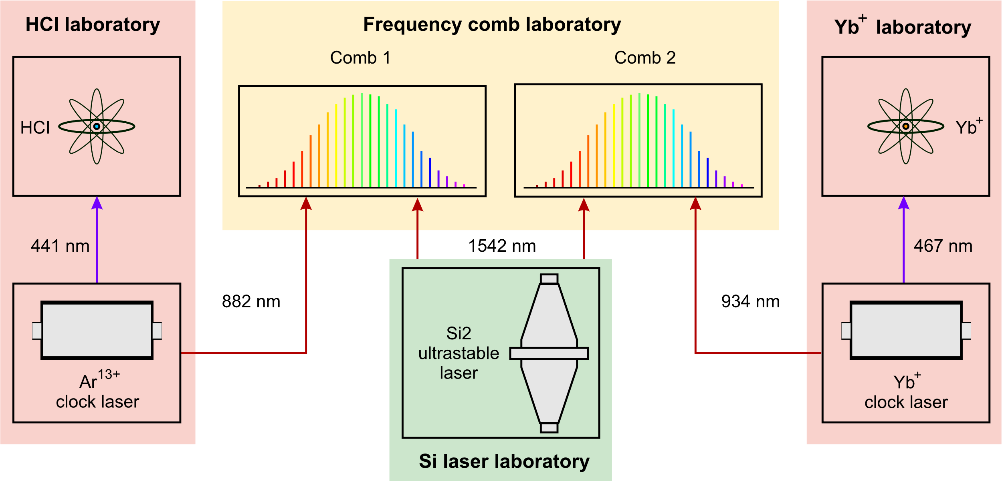
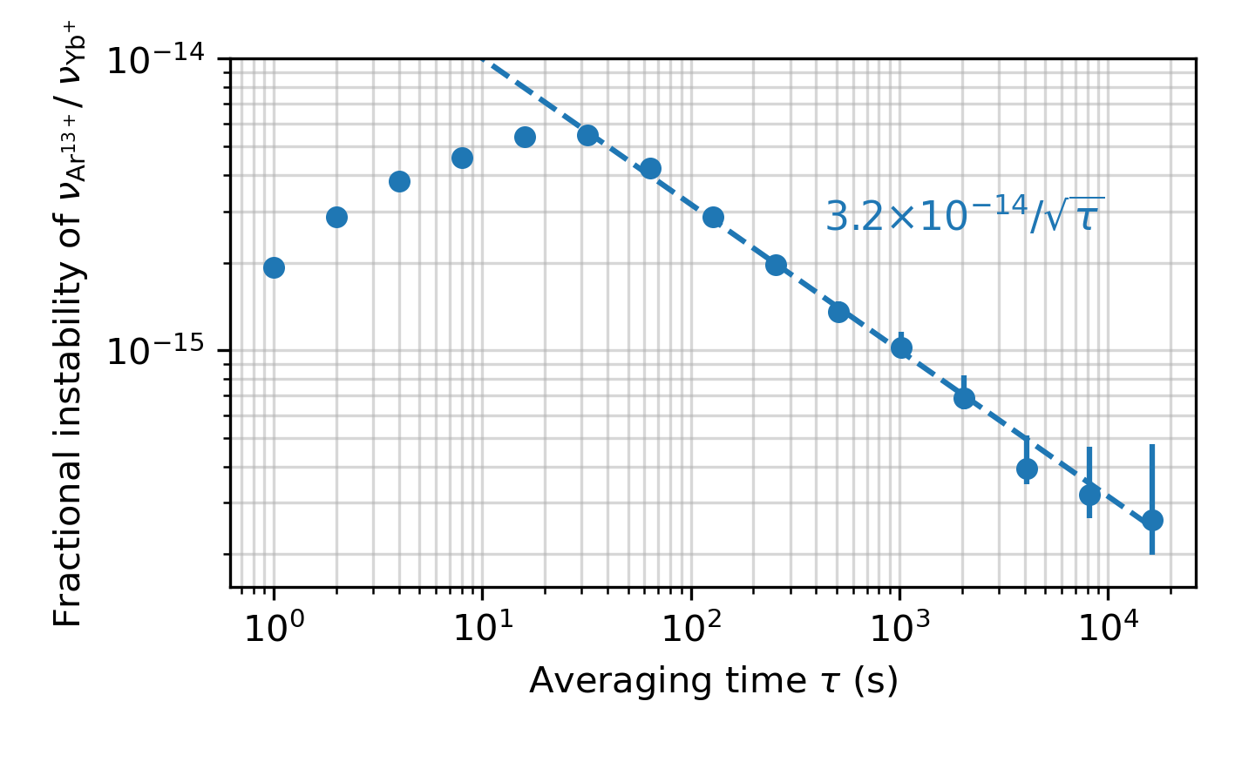
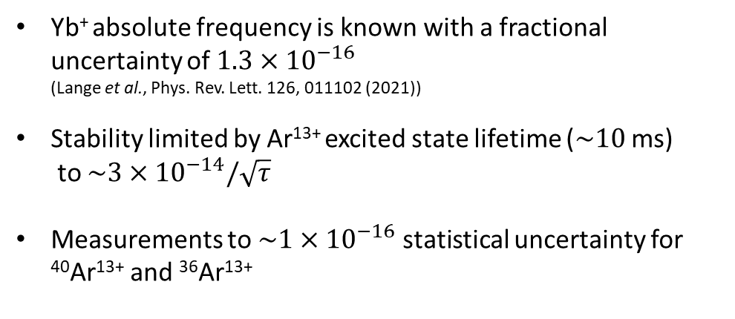
Clock comparison
Matei et al., Phys. Rev. Lett. 118, 263202 (2017)
Yb⁺ absolute frequency is known with a fractional uncertainty of $1.3×{10}^{−16}$
(Lange et al., Phys. Rev. Lett. 126, 011102 (2021))
Stability limited by Ar¹³⁺ excited state lifetime ($\sim 10$ ms)
to $\sim 3×{10}^{−14}/\sqrt{τ}$
Measurements to $\sim 1×{10}^{−16}$ statistical uncertainty for ⁴⁰Ar¹³⁺ and ³⁶Ar¹³⁺
King, Spieß et al., Nature 611, 43–47 (2022)

Slide 13
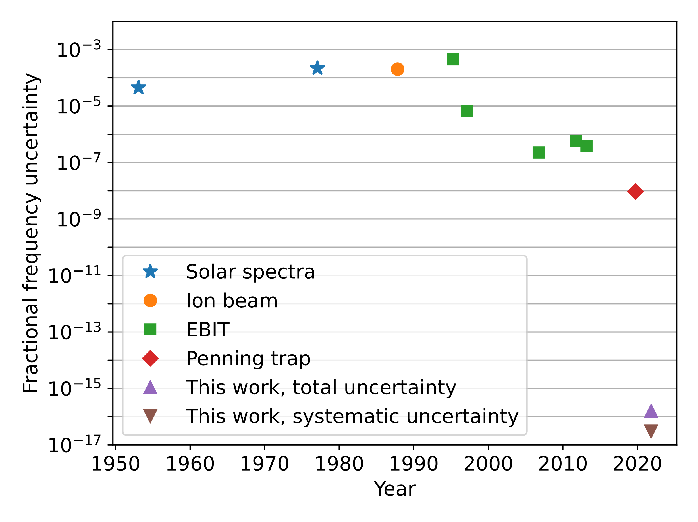
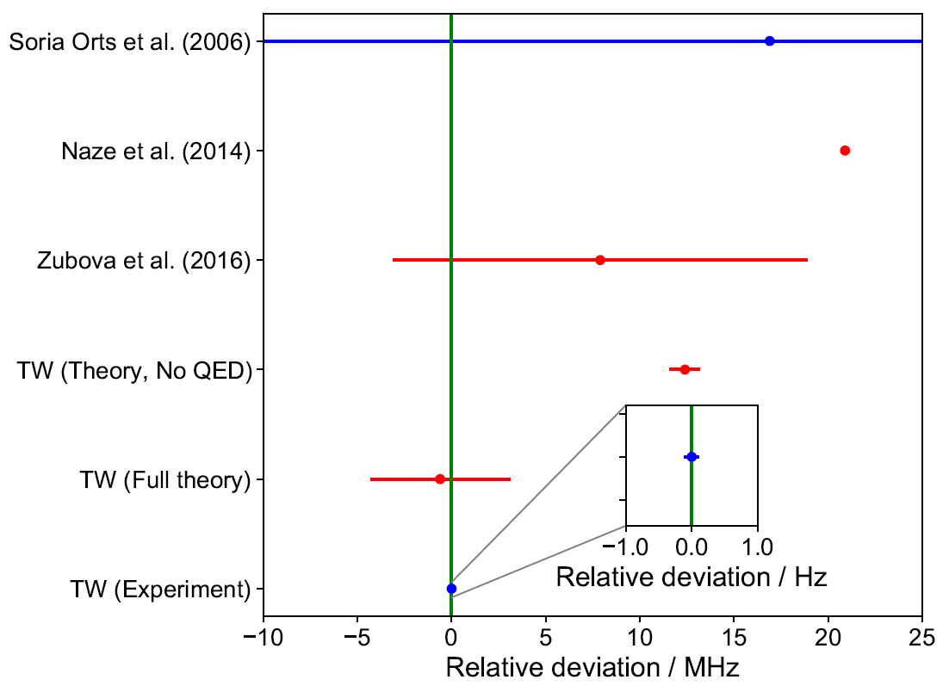
Absolute frequency
 | Absolute frequency (GHz) | Relative uncertainty | Method
⁴⁰Ar¹³⁺ [1] | 679 216.464 (6) | 8.8 x 10⁻⁹ | Penning trap
IS [2] ⁴⁰Ar¹³⁺ - ³⁶Ar¹³⁺ | 1.89 (9) | 4.8 x 10⁻² | EBIT
⁴⁰Ar¹³⁺ | 679 216.462 397 957 42 (11) | 1.5 x 10⁻¹⁶ | QLS
IS ⁴⁰Ar¹³⁺ - ³⁶Ar¹³⁺ | 1.878 110 532 52 (11) | 5.7 x 10⁻¹¹ | QLS
Best previously
published values
[1] Egl et al., Phys. Rev. Lett. 123, 123001 (2019)
[2] Soria Orts et al., Phys. Rev. Lett. 97, 103002 (2006)
Improvment by almost eight and nine
orders of magnitude respectively
King, Spieß et al., Nature 611, 43–47 (2022)

Slide 14
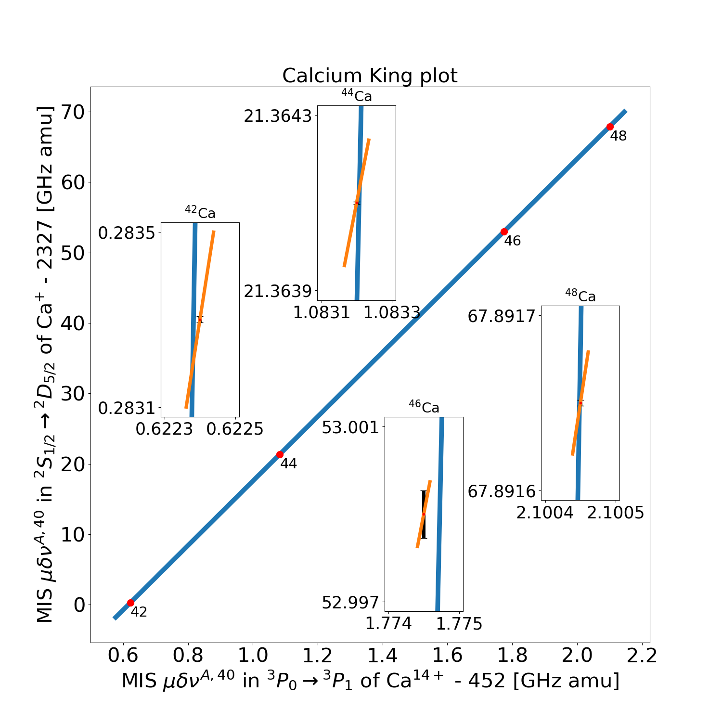
King plot of Ca¹⁴⁺
Ca¹⁴⁺
570nm
10 ms
Stable, even isotopes:
⁴⁰Ca, ⁴²Ca, ⁴⁴Ca, ⁴⁶Ca, ⁴⁸Ca
Preliminary
King plot analysis of isotope shifts:
Linear relationship between two transition in the same element
Non-linearity → New physics or higher-order SM
Limited by uncertainty in
Mass (K. Blaum, MPIK Heidelberg)
Ca⁺ isotope shift (J. Home, ETH Zürich)
Ca⁺ data from F. Knollmann et al., PRA 100, 022514 (2019)

Slide 15
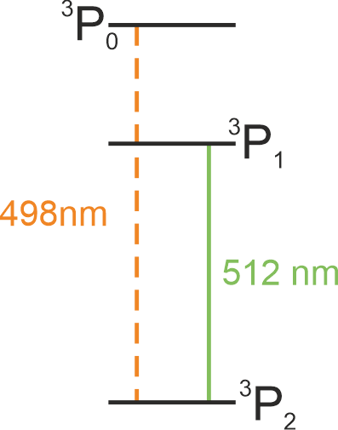

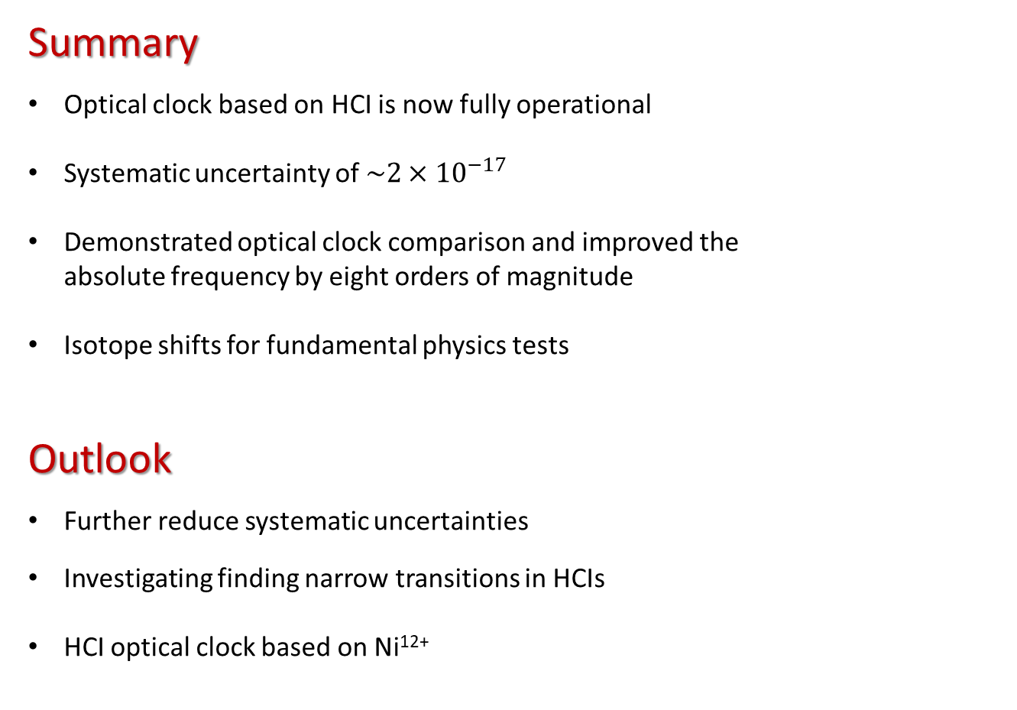

Summary and outlook
Summary
Optical clock based on HCI is now fully operational
Systematic uncertainty of $\sim 2×{10}^{−17}$
Demonstrated optical clock comparison and improved the
absolute frequency by eight orders of magnitude
Isotope shifts for fundamental physics tests
Outlook
Further reduce systematic uncertainties
Investigating finding narrow transitions in HCIs
HCI optical clock based on Ni¹²⁺
Ni¹²⁺
$$τ=20 s$$
$$τ=7 ms$$

Slide 16
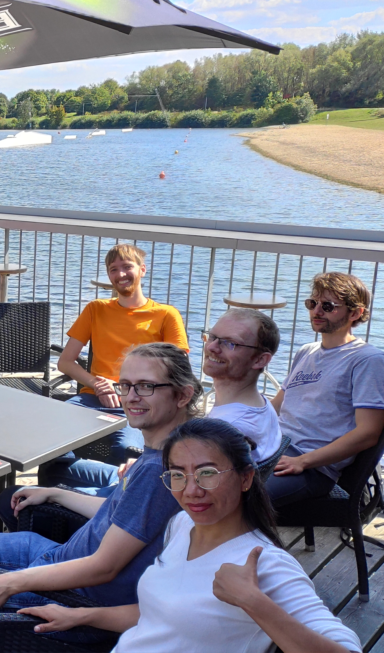
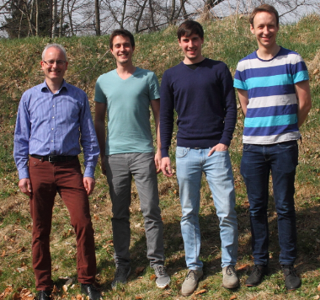





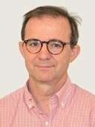


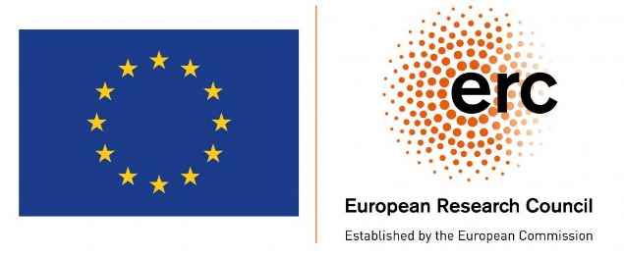
Acknowledgments
Yb⁺ Experiment
Richard Lange (PTB)
Melina Filzinger (PTB)
Nils Huntemann (PTB)
Frequency comb
Erik Benkler (PTB)
Theory
Robert Müller (PTB)
Vladimir Yerokhin (MPIK)
Andrey Surzhykov (PTB & TU Braunschweig)
HCI Experiment
PTB: Piet O. Schmidt, Steven A. King, Tobias Leopold, Peter Micke, LJS, Alexander Wilzewski, Malte Wehrheim, Shuying Chen
MPIK: José R. Crespo López-Urrutia, Lisa Schmöger, Maria Schwarz

